Slide 1





Personalization “Must-Haves”: The Blueprint for Success at Scale
Drew Burns | Group Product Marketing Manager, Adobe Target
ADOBE TARGET
© 2019 Adobe. All Rights Reserved. Adobe Confidential.

Slide 2
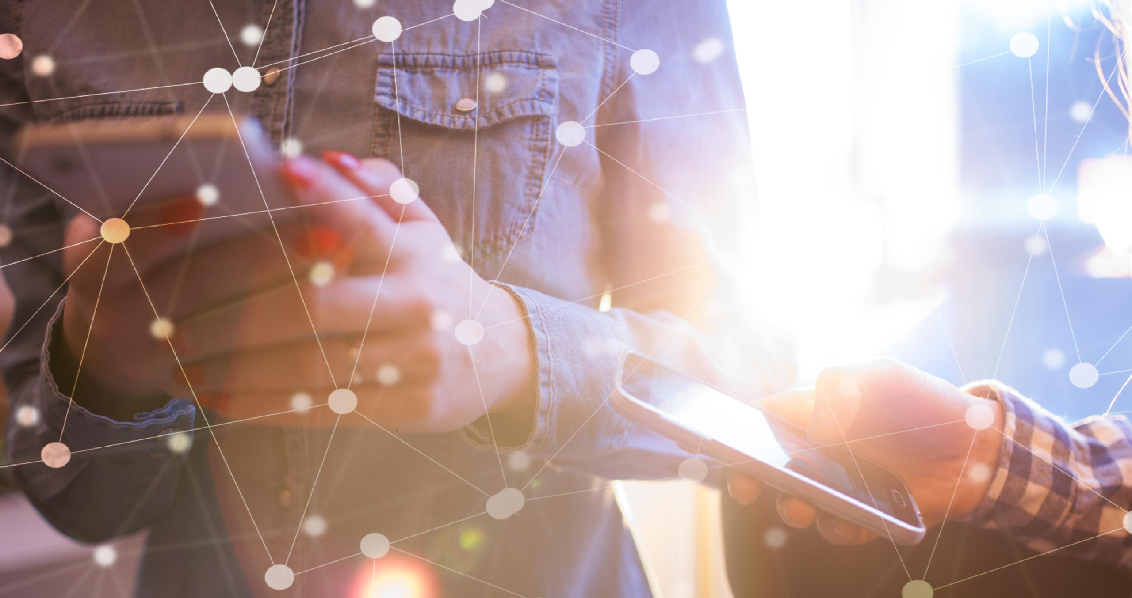






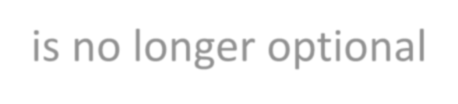

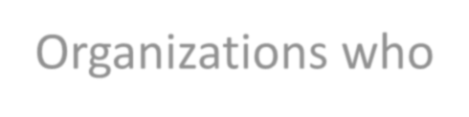
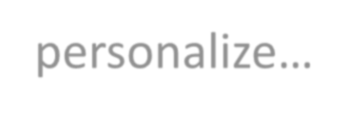

PERSONALIZATION
is no longer optional
Reduce acquisition costs by as much as 50%
Increase revenues by up to 15%
Organizations who personalize…
Improve marketing spend efficiency by 10-30%
Source: Harvard Business Review
© 2019 Adobe. All Rights Reserved. Adobe Confidential.

Slide 3

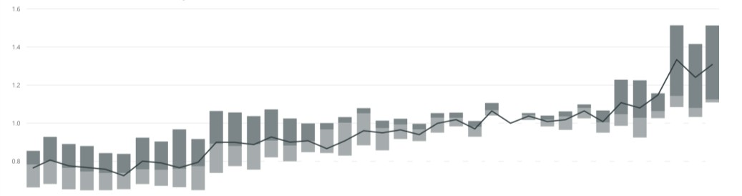
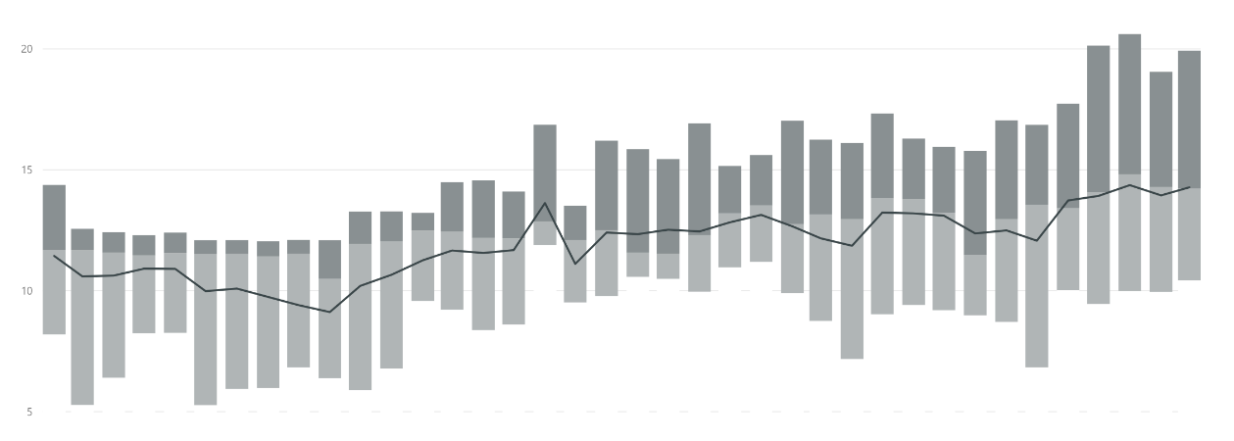
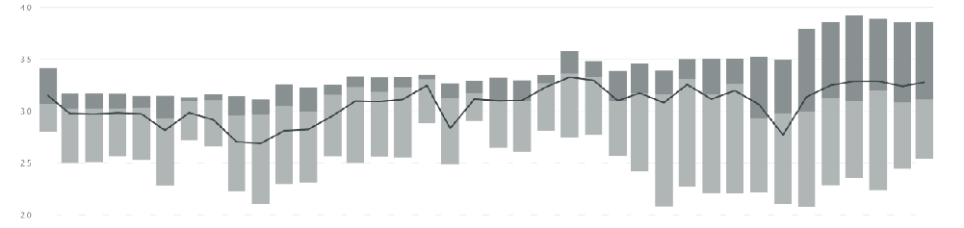
Industry leaders are pulling away from competitors
KEY TAKEAWAYS
1.
6
1.
4
1.
2
1.
0
Visits growth (benchmark 4/2017)
Leaders are increasing visits at a faster pace
0.
Average time spent per visit
6
0
2
(minutes)
1
5
Distance between leaders and laggards grew over last two years in key engagement metrics
1
0
5
4.0
3.5
3.0
2.5
2.0
Visits per visitor
July 2015
Jan 2016
July 2016
Jan 2017
July 2017
Jan 2018
₂nd quartile
₃rd quartile
Average
Source: Adobe Digital Insights,
© 2019 Adobe. All Rights Reserved. Adobe Confidential.
2018

Slide 4


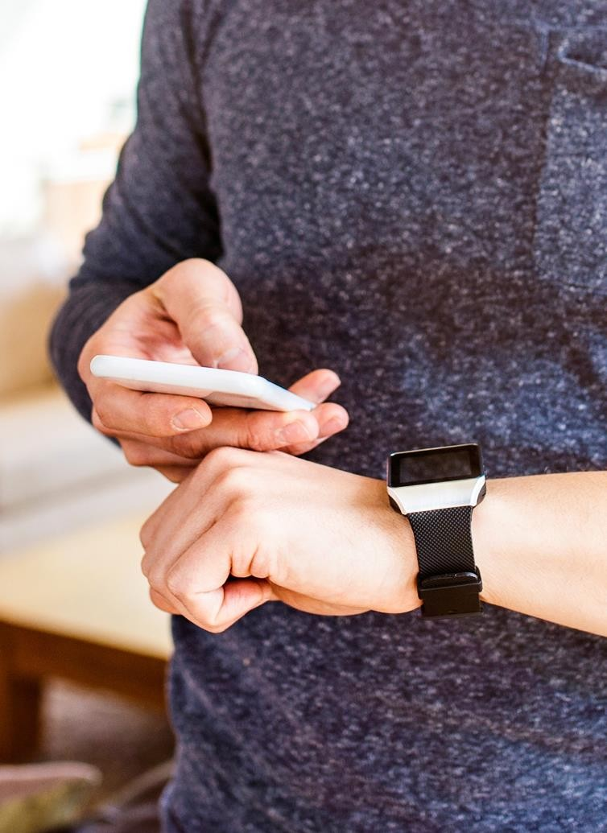


What sets leaders apart: Creating meaningful moments
Receiving the discount or package just right for you
Having a seamless experience across device & touchpoint
Experiencing exceptional service and ease of
© 2018 Adobe Systems Incorporated. All Rights Reserved. Adobe Confidential.
engagement

Slide 5

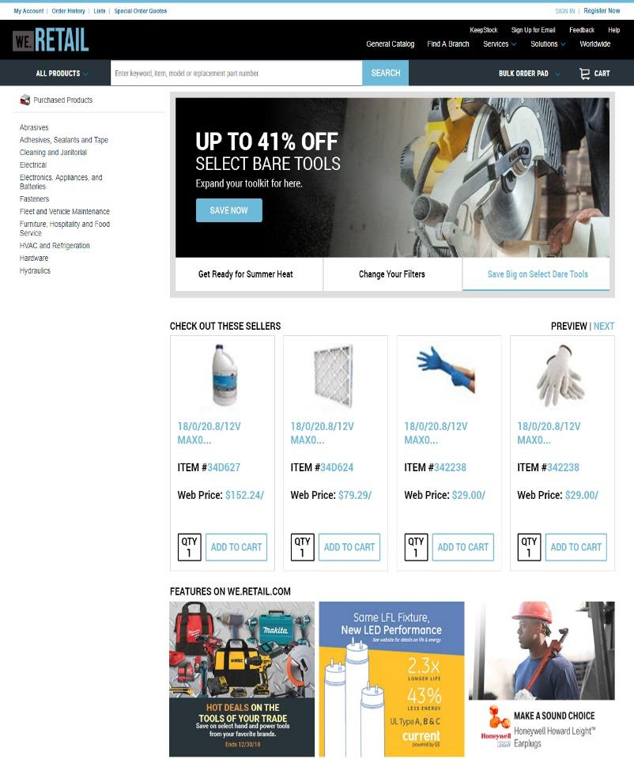
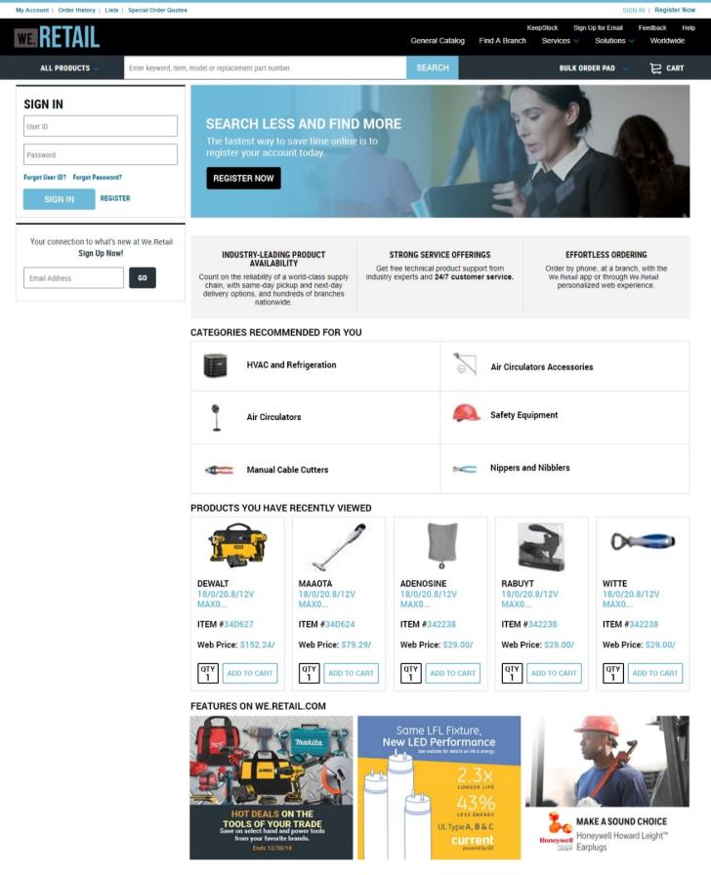
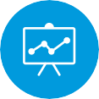

It takes more than just testing: Adaptive personalization
Results
• +7% sign-in rate
• +17% registration rate
• +25% to +75% hero engagement rate
• +12% Product Recs engagement rate
• +200% Product Recs revenue
• +2% Category Recs engagement

Slide 6

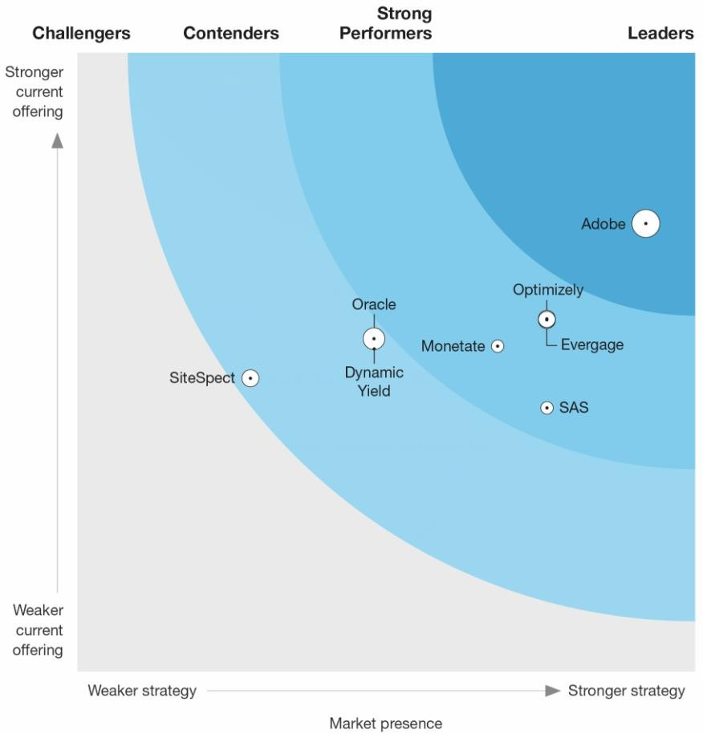
Forrester Wave™: Experience Optimization Platforms, Q2 2018
Forrester’s take on Adobe:
Adobe Target scores well across all experience optimization techniques. Specifically, the product impresses with its testing and targeting capabilities.
The vision for Adobe Target Premium is to use AI techniques to enable marketing and data scientists to optimize experiences within channels and across customer journeys.
Source: Forrester Research, Inc. Forrester Wave™: Experience Optimization Platforms, Q2 2018
The Forrester Wave™ is copyrighted by Forrester Research, Inc. Forrester and Forrester Wave™ are trademarks of Forrester Research, Inc. The Forrester Wave™ is a graphical representation of Forrester's call on a market and is plotted using a detailed spreadsheet with exposed scores, weightings, and comments. Forrester does not endorse any vendor, product, or service depicted in the Forrester Wave. Information is based on best available resources. Opinions reflect judgment at the time and are subject to change

Slide 7



Blueprint for personalization success
Laying the foundation
Data, governance & resources
Establish a plan
short & long-term goals
Accelerate growth with A.I.
use automation to maximize efficiency, insights & ROI

Slide 8
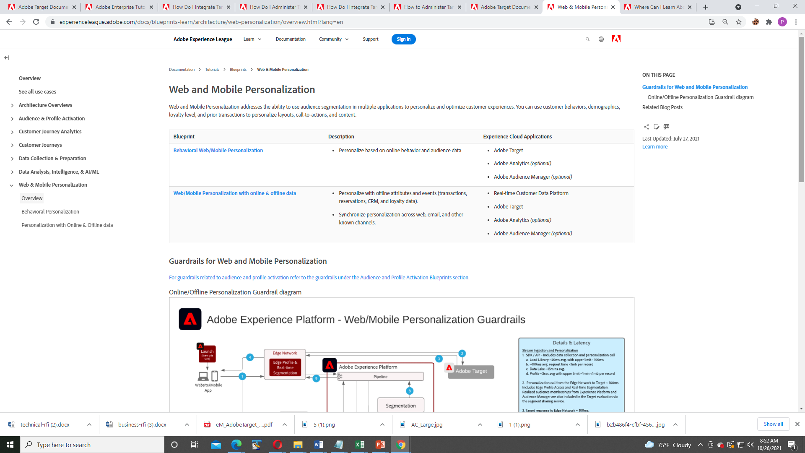

Slide 9
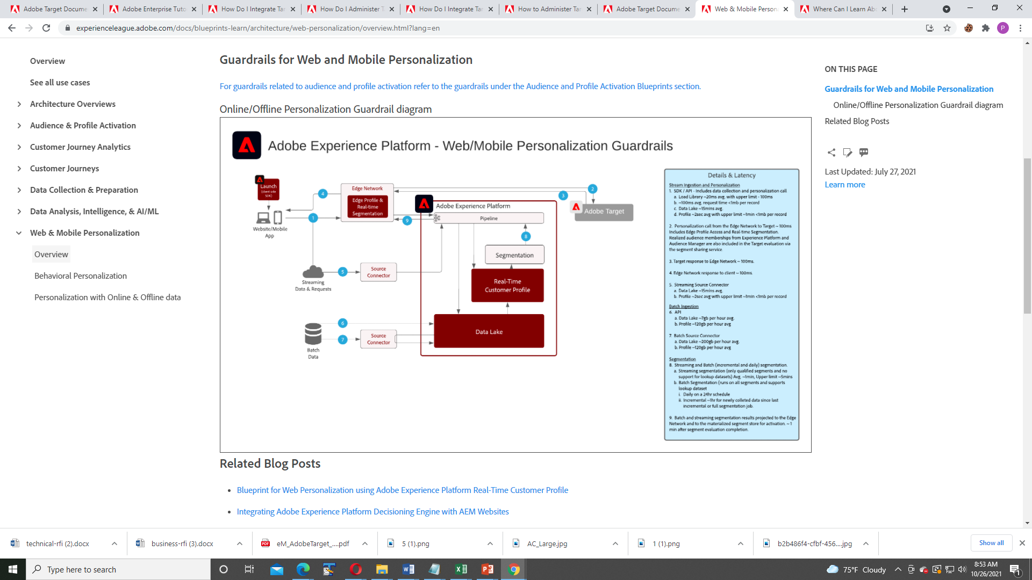

Slide 10
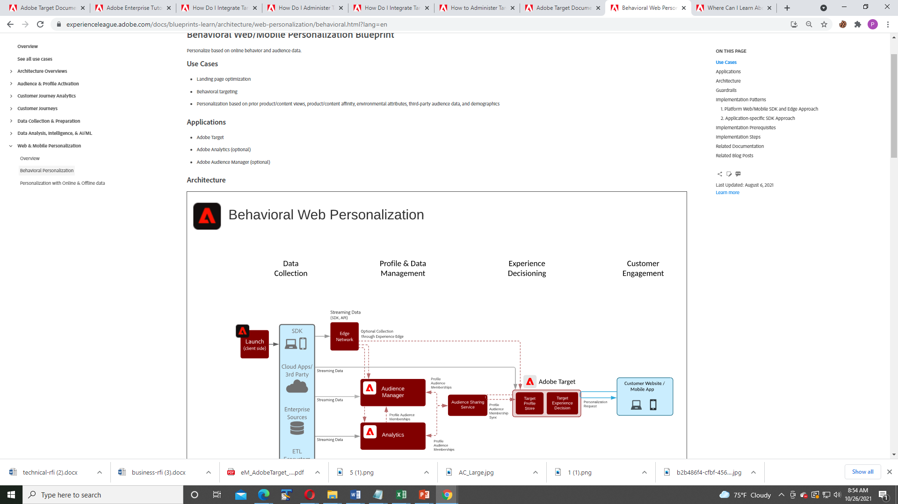

Slide 11
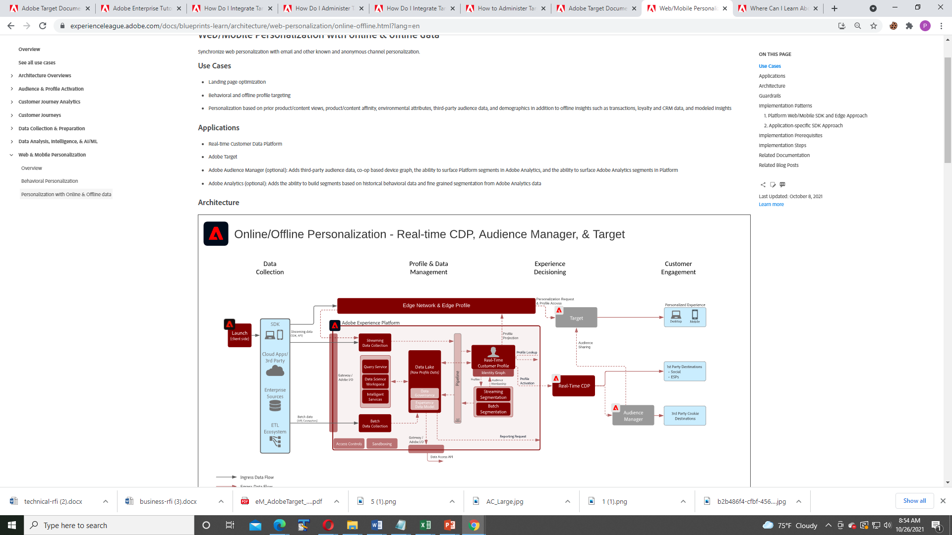

Slide 12
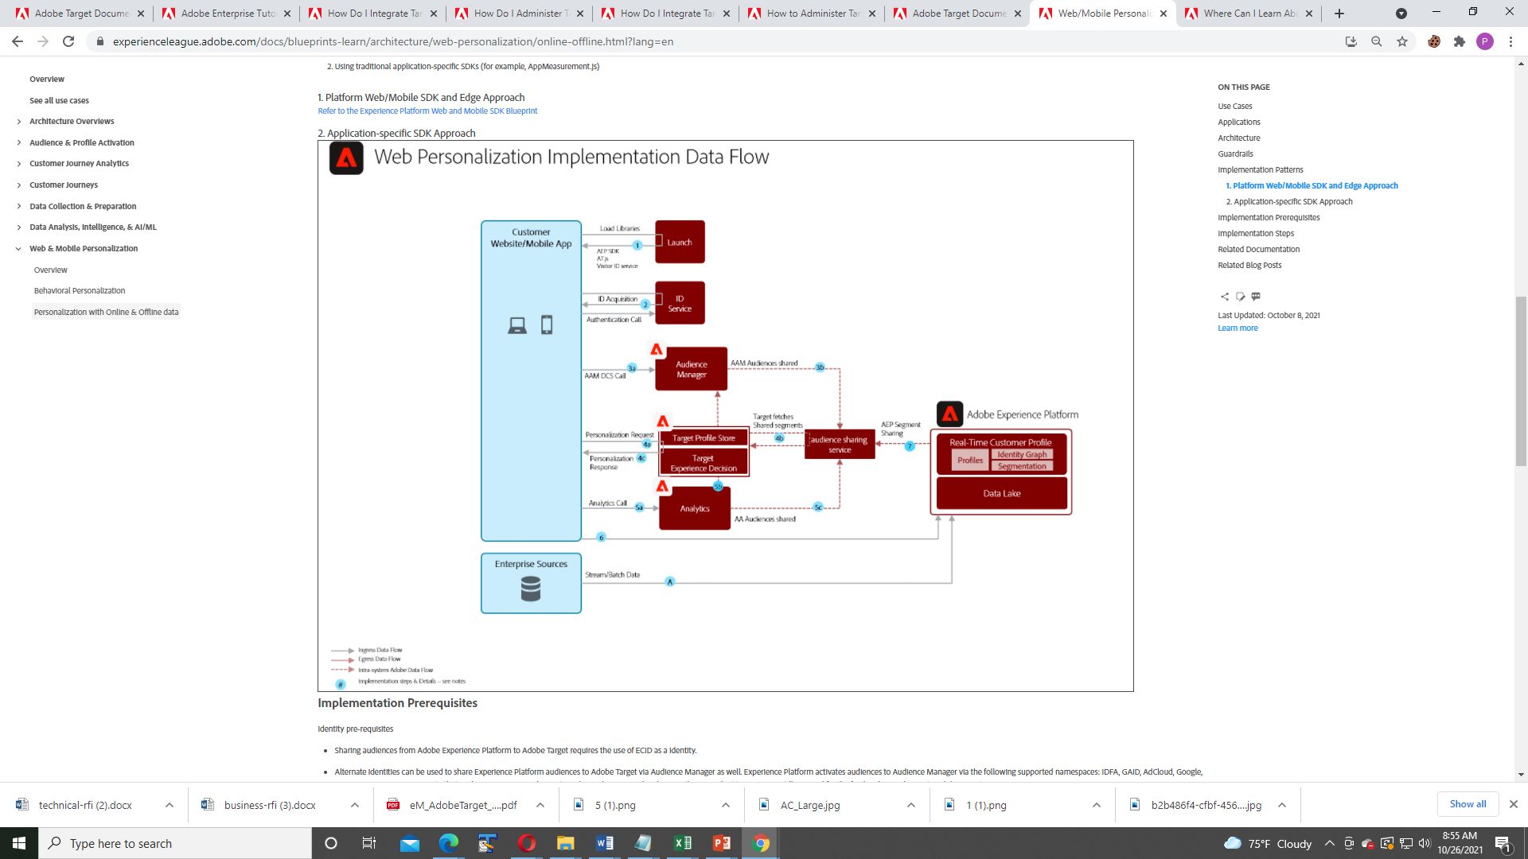

Slide 13
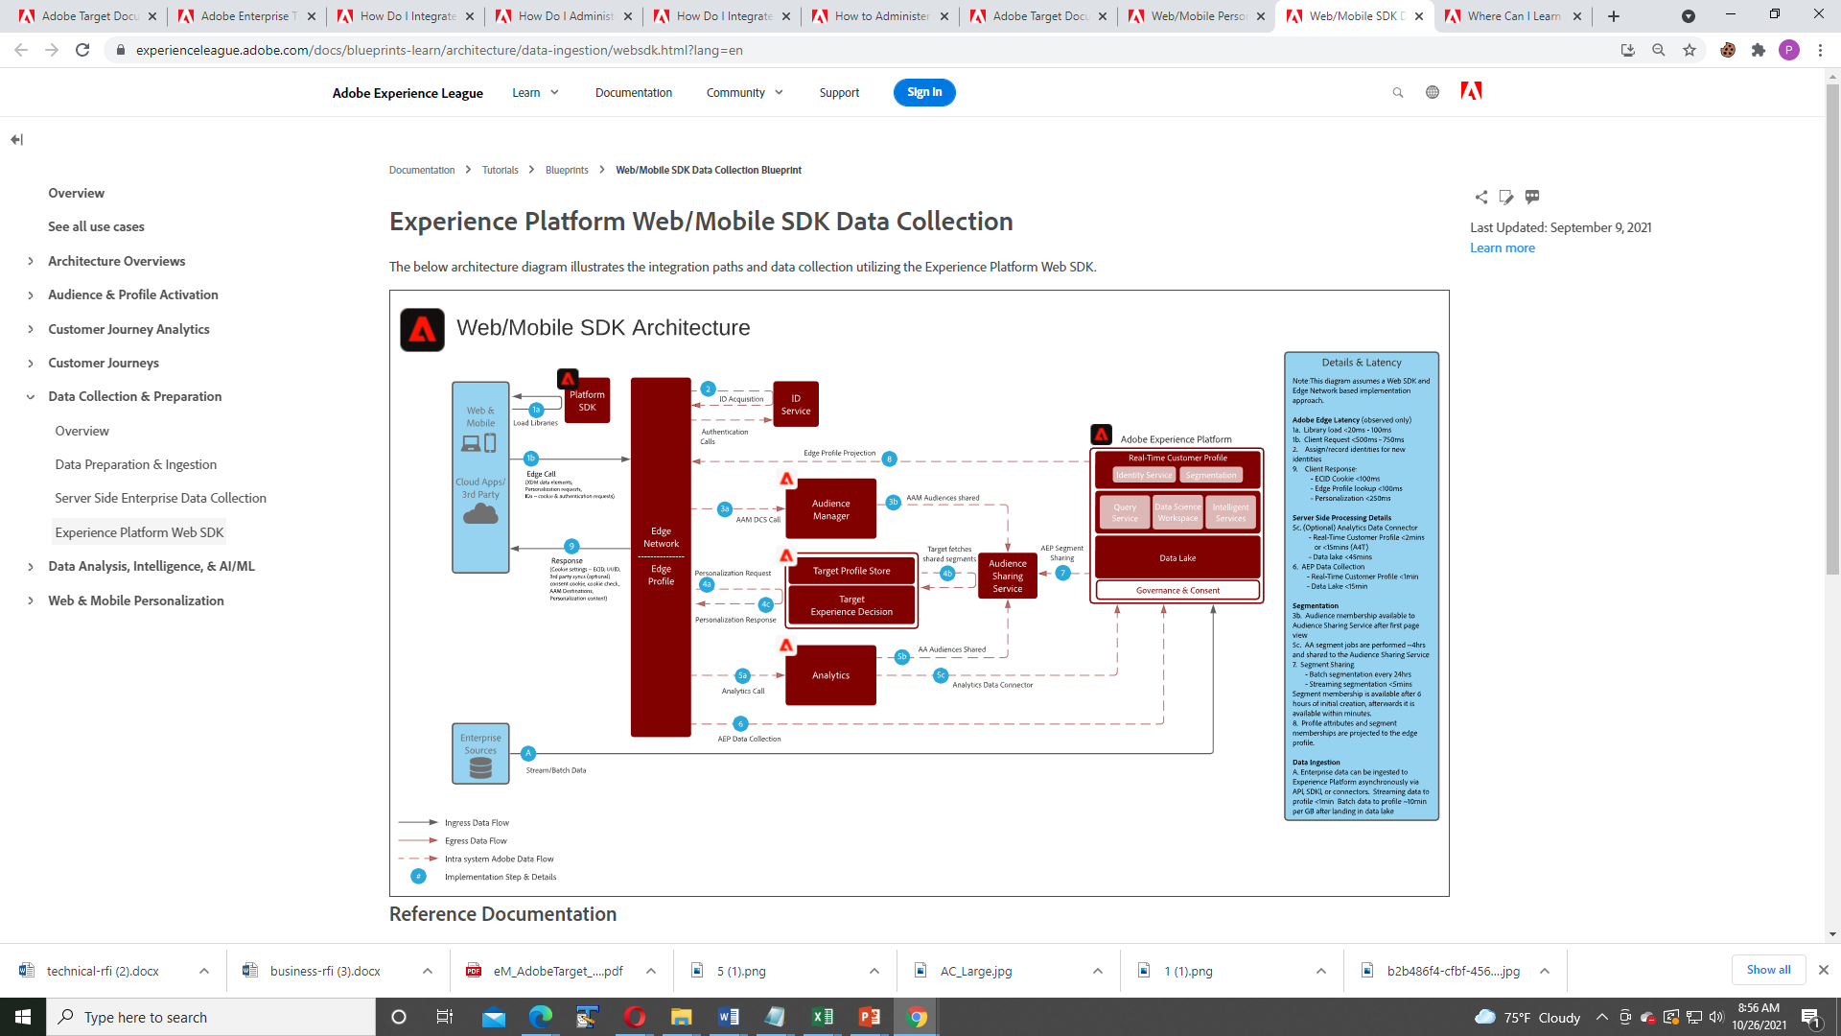

Slide 14
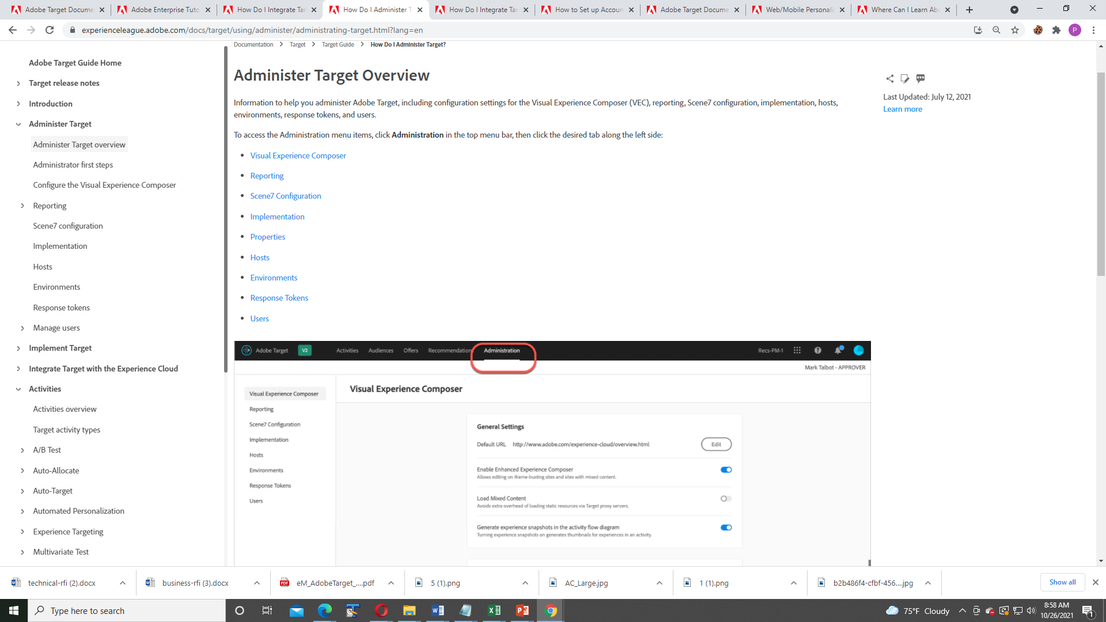

Slide 15
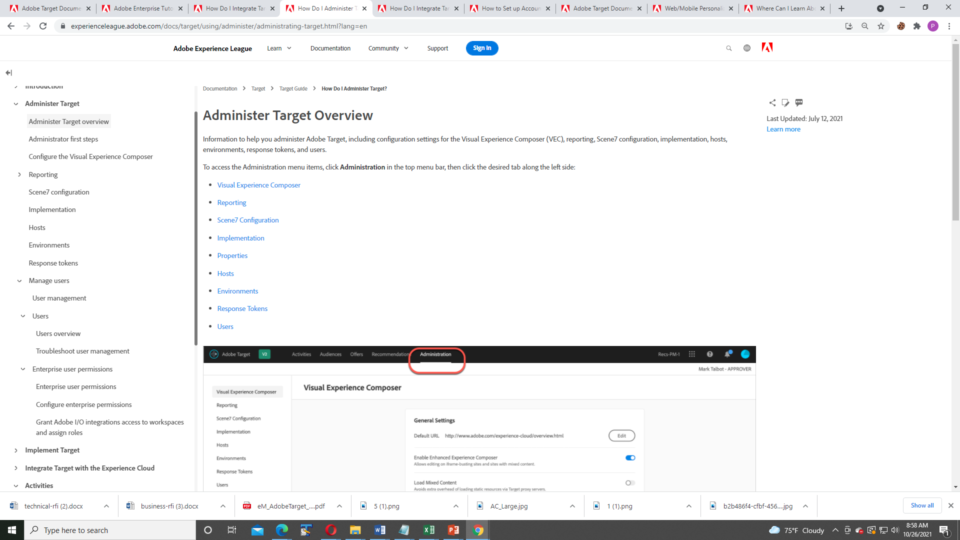

Slide 16
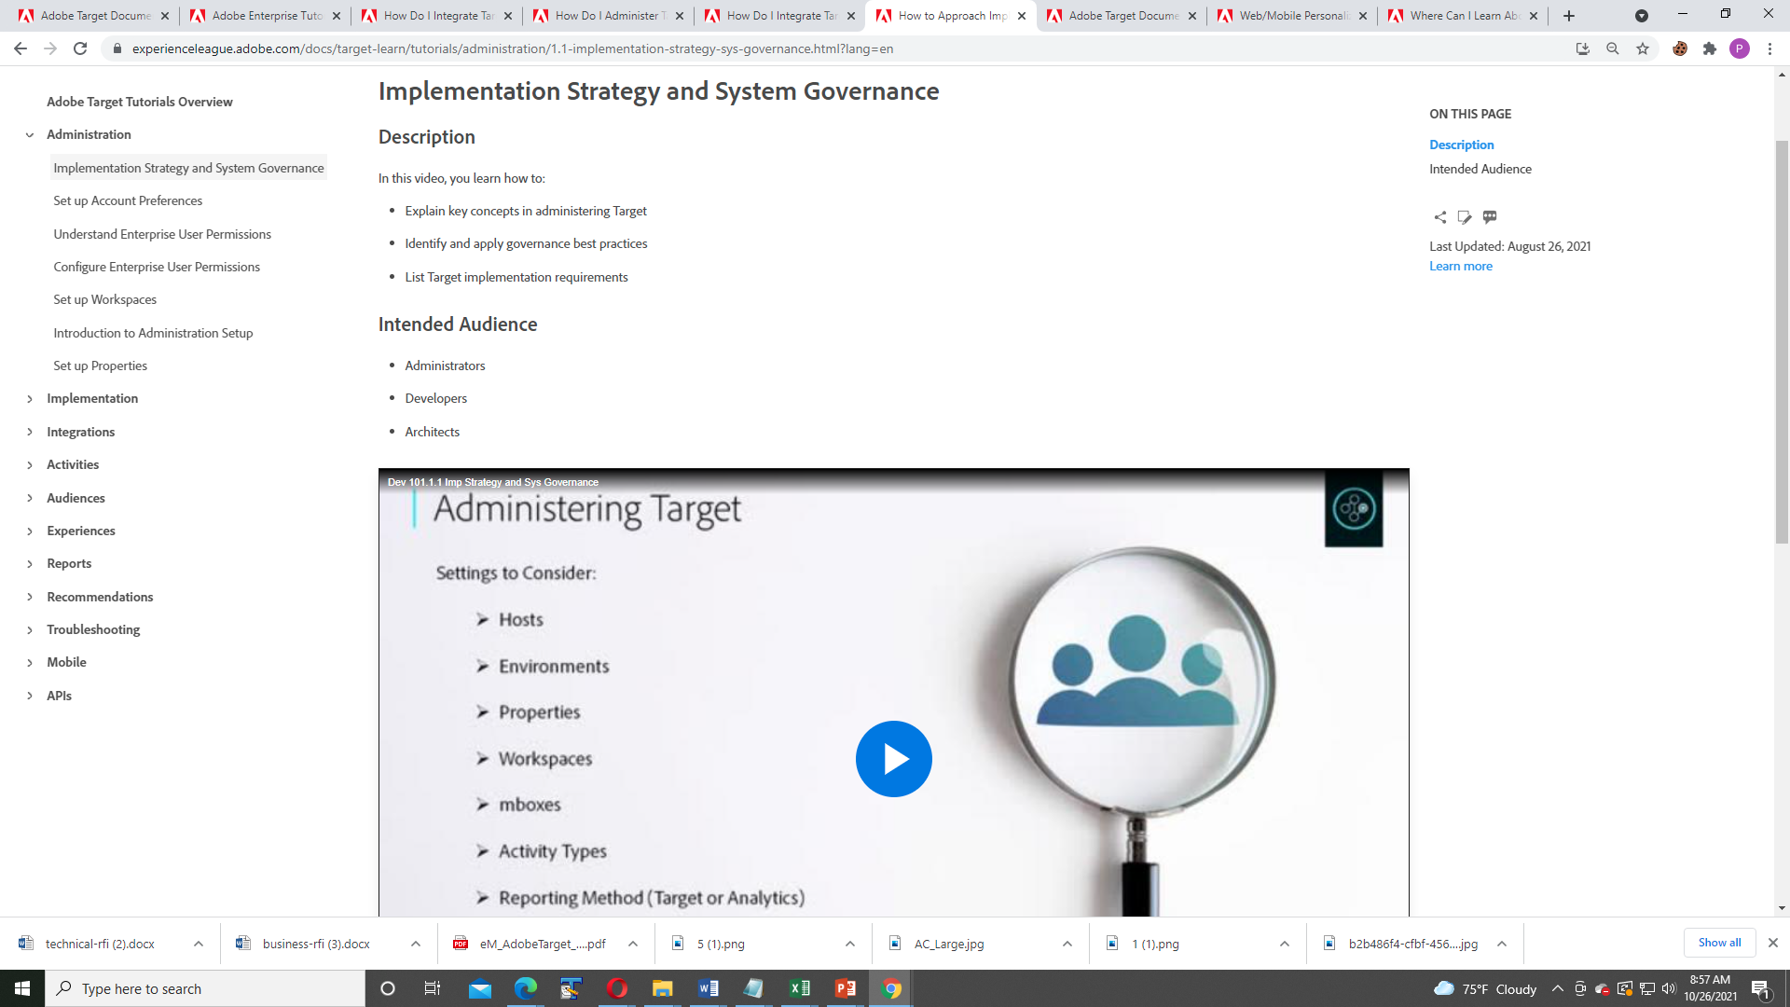

Slide 17
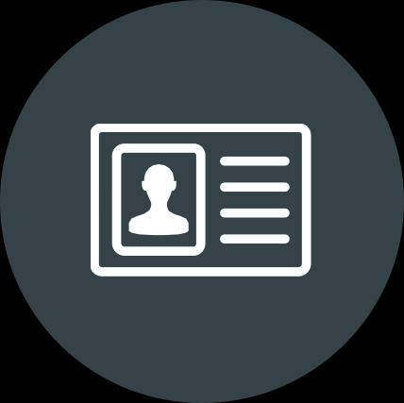

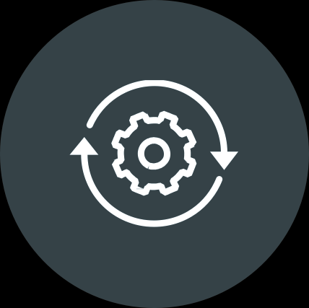
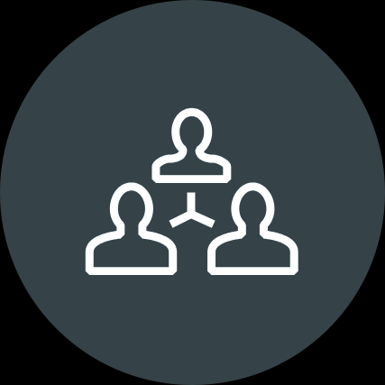
Part 1: Laying the foundation
Profile data
Platform
Process
Culture

Slide 18

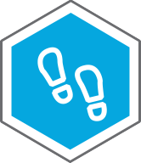


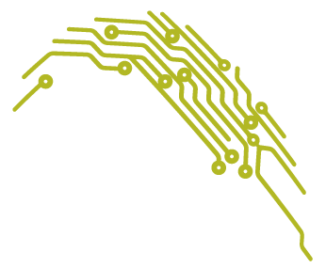
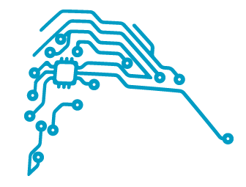
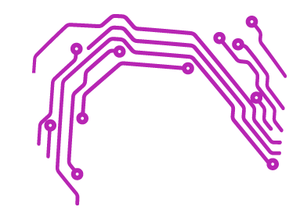




Data: A unified, progressive profile spanning every touch point
Adobe Target
Environment variables
+ IP address
Site behavior variables
+ Customer / Prospect
Offline variables
+ CRM / CDP
+ Call center
+ 2nd party data
+ 3rd party data
Referrer variables
+ Referring domain
+ Campaign ID
+ Affiliate / PPC
+ Natural search
+ Country of origin
+ New/return visitor
+ Time zone
+ Previous visit patterns
+ Device Type
+ Interests and Affinities
+ Operating System
+ Browser
+ Previous purchases
+ Previous activity exposure
+ Mobile Carrier
+ Previous activity responses
+ Connection Speed
Temporal variables
Experience Cloud
+ Adobe Analytics
+ Adobe Audience Manager
+ Adobe Campaign
+ Core Services
+ Screen resolution
+ Time of day
+ Day of week
+ Recency
+ Frequency

Slide 19



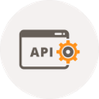

A unified open architecture: Multiple delivery methods
Web
App
Everywhere
Web
Mobile web
SPA (Angular, React, etc.)
Native apps
Hybrid apps
Server-server delivery
Javascript restricted environments
Internet connected devices

Slide 20




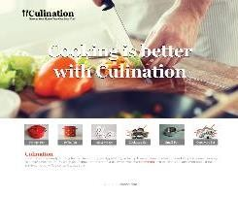
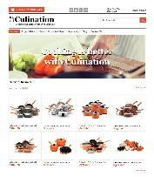

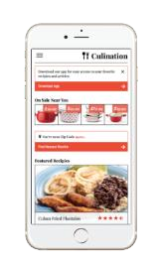
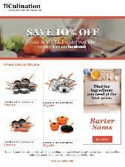
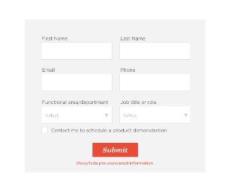
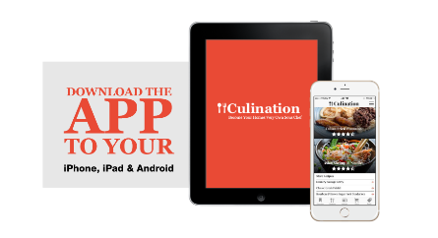
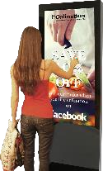

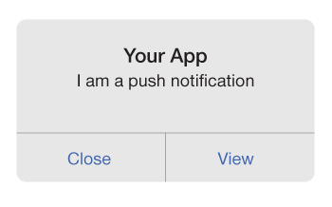

Success events can include
Any on-site actions Any on-site page views
Engagement: page views Engagement: time on site Engagement: score Revenue
Average order value Revenue per visit
Offline conversion events
Any analytics event
Clicks on display ad
Targeted landing page
Optimized category page
Personalized mobile landing page
Retargeting email: Personalized offer with content Recommendations
Abandon partial form complete
Optimized banner to download app
Targeted push notification near store/point of interest
Receives personalized offers and recommendations on
in-store digital kiosk

Slide 21
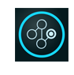
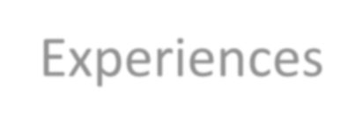
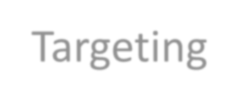
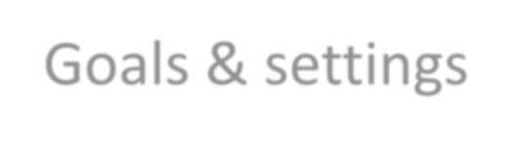
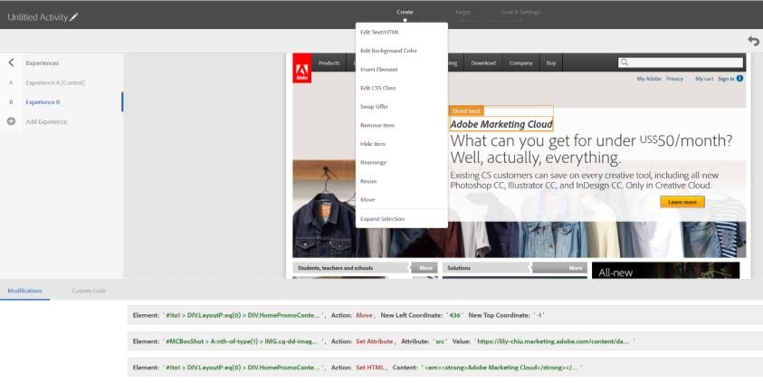
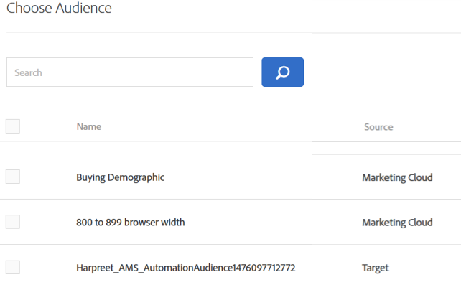
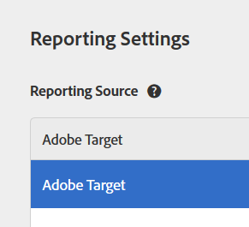
A scalable experience optimization platform
Experiences Targeting
Goals & settings
TESTING
RULES-BASED PERSONALIZATION
ALGORITHMIC PERSONALIZATION
A/B…n testing
Testing multiple experience variants
Geo-targeting
Geo-location or GPS targeting
Personalized recommendations
Automating next best suggestions
Multivariate testing
Testing combo of elements & contribution
Account/profile-based targeting
Rules-based targeting
Automated personalization
Automating rank-ordered offers
Auto-allocation
Self-optimizing test
Behavioral targeting Real-time actions & category
affinity/scores
Auto-target Experience personalization

Slide 22

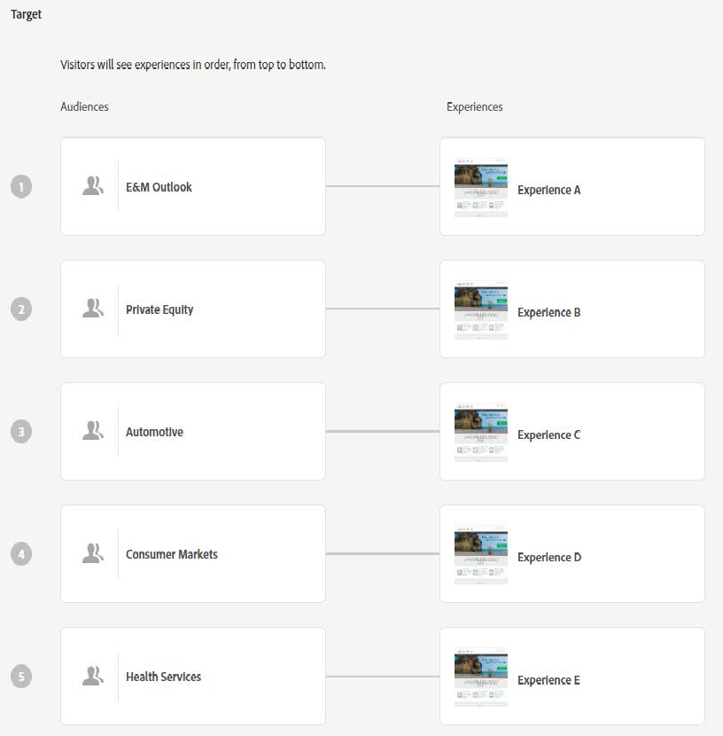
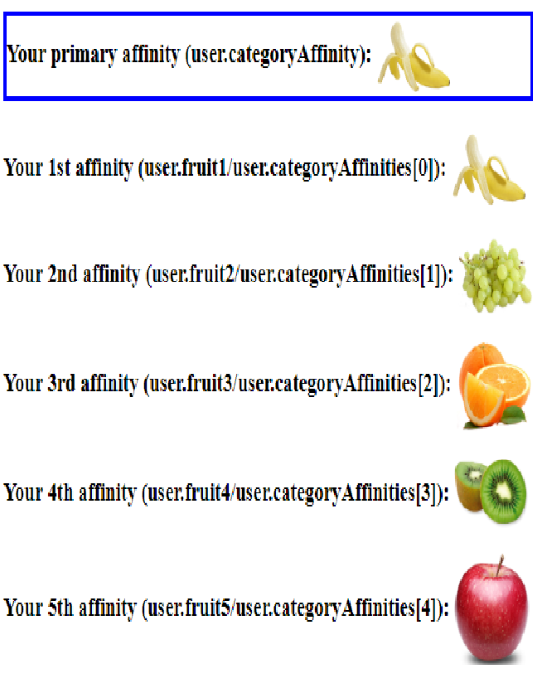
Rules-based personalization strategies
ACCOUNT OR PROFILE-BASED TARGETING
BEHAVIORAL TARGETING
Directly map experiences to pre-defined segments based on mutually identified strategies
Recency/Frequency scorers based on defined inputs like page category (category affinity)

Slide 23
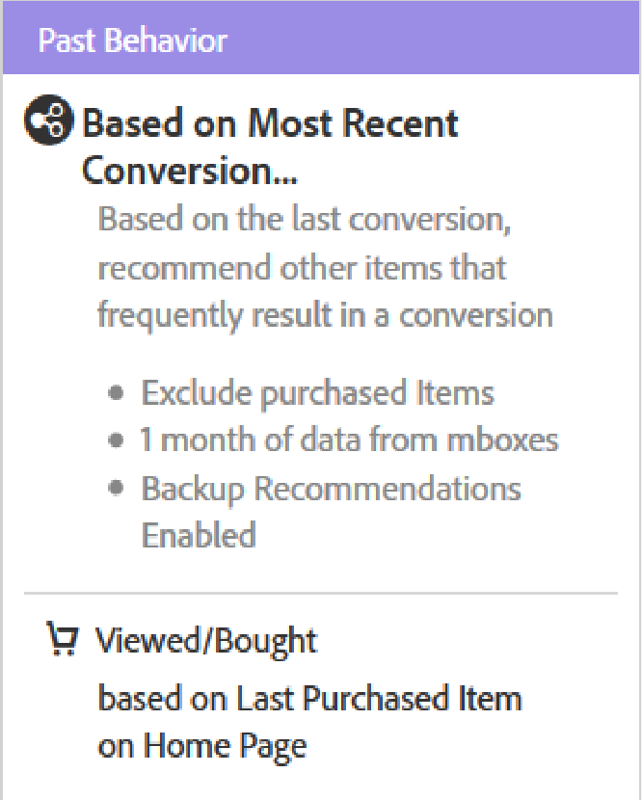
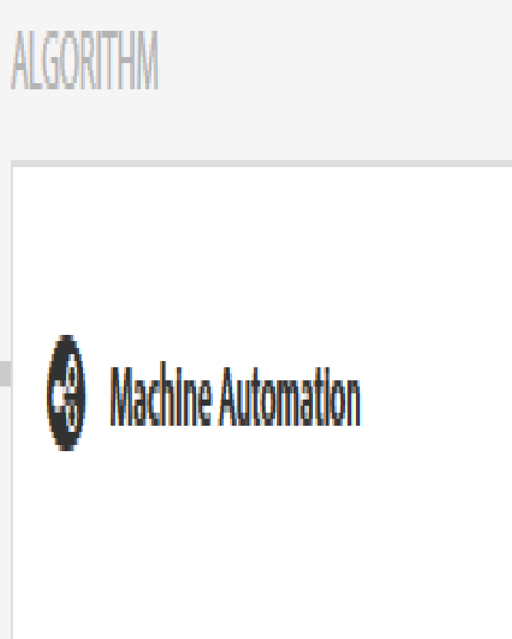
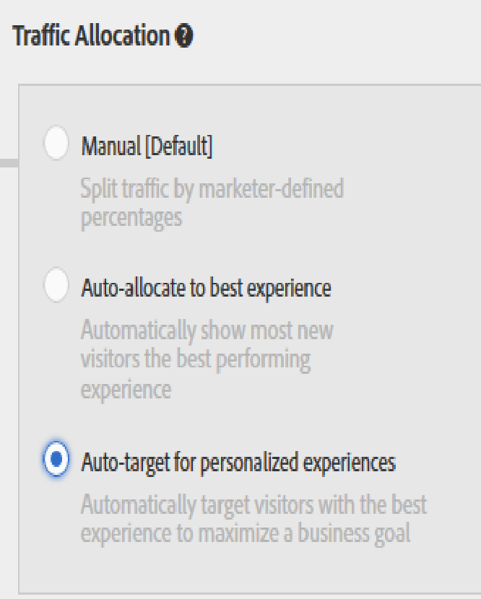
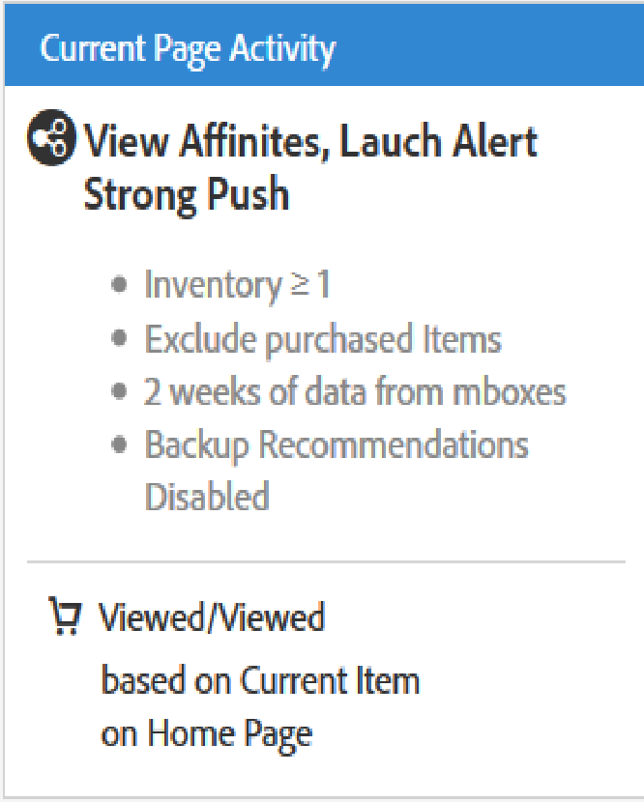

Automated and algorithmic strategies
AUTOMATED OFFERS Choose best option for each individual from any combination of selected content or offers.
PRODUCT AND CONTENT RECOMMENDATIONS
Deliver ideal products, content, or offers to display based on individual user behavior and context
AUTOMATED AB TESTS
Choose best experience for each individual from a bucket of pre- defined experiences

Slide 24


Aligning with Analytics: taking action off of shared audience segments

Slide 25





Think bigger
You can break down any test by any audience, using any metric.
17

Slide 26



Personalization insights report
Personalization Insights enable customers to understand how AI activities are generating lift by exposing key attributes used in modeling and even automated segments that were created by the AI.

Slide 27




Part 2: Establish a plan
ADOBE TARGET
1. Conversion/KPI lift e.g. reducing bounce rates
25x
Conservative average of ROI
From Adobe Target activities
2. Organizational efficiencies e.g. creative savings
Organization cost savings e.g. call deflection
Value of insights e.g. audience preferences
Opportunity costs of “failing fast” e.g. losses

Slide 28






The right way to nurture a relationship…from first to every touch point
ACQUISITION CONVERSIONS & REPEAT VISITS
LOYALTY
RESULTS
363% lift in initiating application
55% lift in completing application
RESULTS
5% increase in order volume,
# of clicks reduced from up to 8 to 1
RESULTS
10% increase in logins
9% lift in conversion events

Slide 29






Ideation
Personalized landing pages: targeting, automated personalization, auto- target
Prominence/treatment of CTAs
Reduction of steps to
conversion

Slide 30




Ideation
Category affinity: targeted offers, navigation and recommendations
Recommendations: landing page, conversion & in-between
Remarketing/retargeting: offsite, email, return visit

Slide 31








Ideation
Customer attributes/scoring
Mobile Application
Screens, consoles, kiosks and voice!
incorporating CRM and propensity
Location-based personalization, personalized messaging

Slide 32




Become your own Biz Dev team
ADOBE TARGET

Slide 33
Establish & Refine Workflow
STRATEGIC PLANNING
INDIVIDUAL CAMPAIGNS
Ideation, Feasibility & Planning
Prioritization
Creative, Logic & Compliance
Requirements
Development, QA & Deployment
Results & Recommendations
Objective | Develop roadmap of targeted and testing campaign opportunities | Evaluate and prioritize campaigns across products based upon DTO Goals and TOS capacity | Kick off individual campaigns, develop creative and gain Compliance approval for data, logic and creative | Finalize detailed requirements and capture approval to begin development | Complete development, testing and sign off of campaign | Launch campaign, conduct post launch validation and share campaign reporting
Key Stakeholder | Business Line, UX, Omni Sales, Dev, Marketing | UX, Dev | Business Line / Omni Sales, UX | Business Line / Omni Sales, Dev | Business Line / Omni Sales, Dev | Dev, Business Line / Omni Sales
Analysis: Review, gather and analyze data from multiple sources to inform future product roadmaps and campaigns. Insights are gathered through multiple data inputs and sources. Additional analysis may also be requested from Analytics team.

Slide 34
Program Roadmap & Benchmarks
PHASE 1 (Jan - May)
PHASE 2 (Jun- Jul)
PHASE 3 (Aug-Dec)
2018
Maturity Assessment, Organization Readiness
Ecosystem: Partners, Agencies
1
DIGITAL STRATEGY
Training & Enablement
Content Creation Strategy
Testing Strategy, Data Driven Iterative Tests
Test Creation Strategy
Operational Excellence, Efficient Test and Creative Creation
Analytics Audit, Review and Refresh
Digital Essentials
Analytics Migration to DTM
Membership Tier, Customer Attributes Integration
Implement MCID
DTM Config (Target & AA)
MARKETING EXECUTION & ANALYSIS
Unified Marketing Strategy
Target A/B Tests
Target Experience based tests
Target Premium, Automated Personalization
2
Campaign Customer Profiling
Campaign Channel Setup
Integrate Audience Manager, Marketing Cloud and Campaign
CRM data into Audience Manager
2ND and 3rd Party Data into AAM
Content Technology Foundation
AEM MC Configurations
Digital Assets
Templates & Pages
Workflow
Migrate from old CMS
Target A/B Tests
A/B Testing and Cart Abandonment
Membership Tier Personalization
Personalized Emails Based On Membership Tier
Lookalike targeting
– acquire new members
3
Capabilities and VRI’s

Slide 35









































Set & evaluate quarterly benchmarks & growth
‘20 Goal State
2.5
Now 1.8
STRATEGIC ALIGNMENT
EMBEDDED
EXPANDED
DISCIPLINED
INCIDENTAL
1
2
3
4
5
CULTURE
METHODOLOGY EXECUTION LEADERSHIP ORGANIZATION
 | ✔ | 
 |  | ✔
 | ✔ | 
✔ | 
 | ✔ | 
Adobe Target

Slide 36

Part 3: Accelerate growth with A.I.
ADOBE TARGET

Slide 37






Rules-based personalization
SPEAKING TO CUSTOMERS THE WAY THEY WANT DRAMATICALLY INCREASES SALES
ADOBE TARGET
Before personalization
After personalization Winner
RESULT
1311%
Gross added sales

Slide 38




One-click personalization powered by Adobe Sensei
AI AND MACHINE LEARNING DELIVER THE BEST VERSION TO EVERYONE, EVERY TIME
ADOBE TARGET
Before personalization
Winner
RESULT
13%
Lift in orders

Slide 39













Accelerate A/B testing using auto-allocate
AI USING ADOBE SENSEI DELIVERS THE WINNER TO MORE VISITORS EARLIER FOR MORE REVENUE
ADOBE TARGET
ADOBE TARGET
Experiences
Experience A (13% Visitors/4.02% CR)
Experience D (40% Visitors/5.80% CR)
Winner
RESULT
Experience B (17% Visitors/4.97% CR)
Experience E (1% Visitors/2.22% CR)
Pushed 40% of
traffic to the winning experience, D, with conversion rate (CR) of
5.80%
Experience C (29% Visitors/5.09% CR)

Slide 40




Broader & layered recommendations based on customer journey stage
ADOBE TARGET
Purchasing Recs
Help Articles
Hotel Rooms
Songs
TV Shows
Artists
Restaurants
Products
Apps

Slide 41




Recommendations
CLEARING THE PATH TO PURCHASE INCREASES ORDERS
ADOBE TARGET
Before: Without Recently Viewed Recommendations
After: With Recently Viewed Recommendations Winner
5% Increase in order volume by reducing visit friction
RESULT

Slide 42









$128 BILLION
OF REVENUE – UP 20% FROM 2016.
HAD A HAND IN GENERATING
ADOBE TARGET
Retail continues its upward
Trajectory with Adobe Target.
Helped generate
$75 BILLION in revenue, up from $53 billion in 2016.
Ran an average of 113
personalized experiments.
Personalized experiences for
16.7 Billion visitors to retail sites-almost 2x the visitors in
2016.
Adobe Target plays leading role in
Drove an average of 223,000 conversions per campaign, including launching videos or opening articles.
Personalized campaigns grew 40% in 2017, generating 2.4X the traffic.
Media & Entertainment campaigns.
Financial Services invests more in Adobe Target usage.
Travel @ Hospitality welcomes more travelers
aboard with Adobe Target.
25% more companies used Adobe Target.
Powered 2X the number of personalization campaign as last year.
4.6 billion conversions-3X more than 2016.
4.2 billion travelers received personalized experiences-2x more than 2016.
Delivered close to 40% more personalized experiences to travelers.
Delivered experiences to people
10.2 billion times-4X more than 2016.

Slide 43


Slide 44


Slide 45


Slide 46


Slide 47


Slide 48


Slide 49


Slide 50


Slide 51


Slide 52


Slide 53


Slide 54


Slide 55


Slide 56


Slide 57


Slide 58


Slide 59


Slide 60


Slide 61


Slide 62


Slide 63


Slide 64


